Slide 1
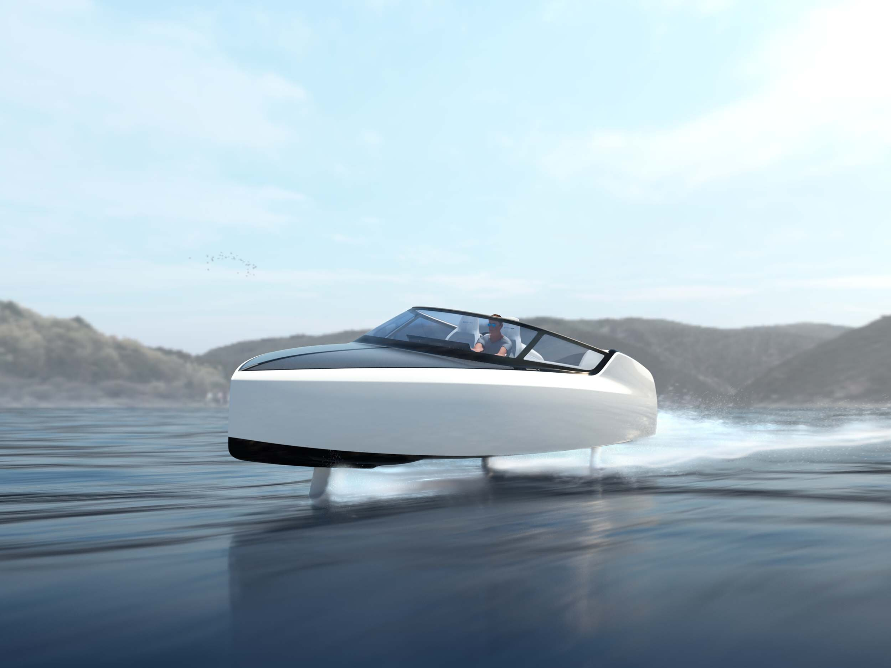
Edorado Marine
HBO – ICT Technology Semester 5
Casey Stijlaart

Slide 2
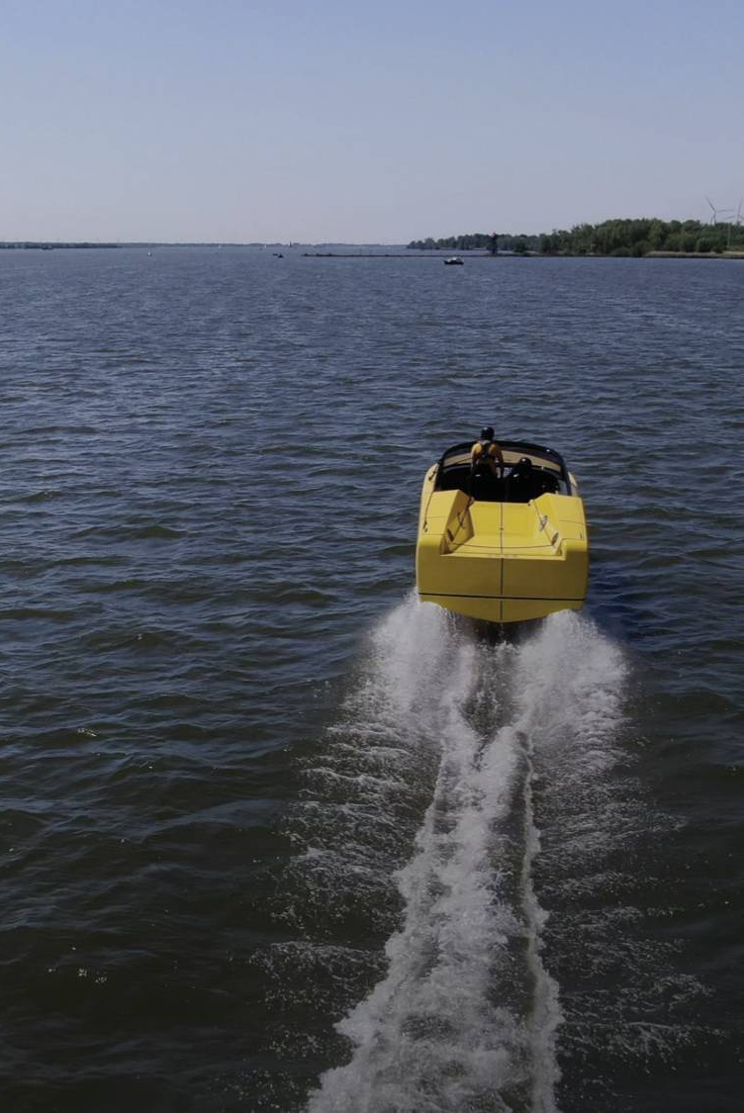
Overview
The company
The project
The approach
Learning Curves
The result

Slide 3
The Company

Slide 4
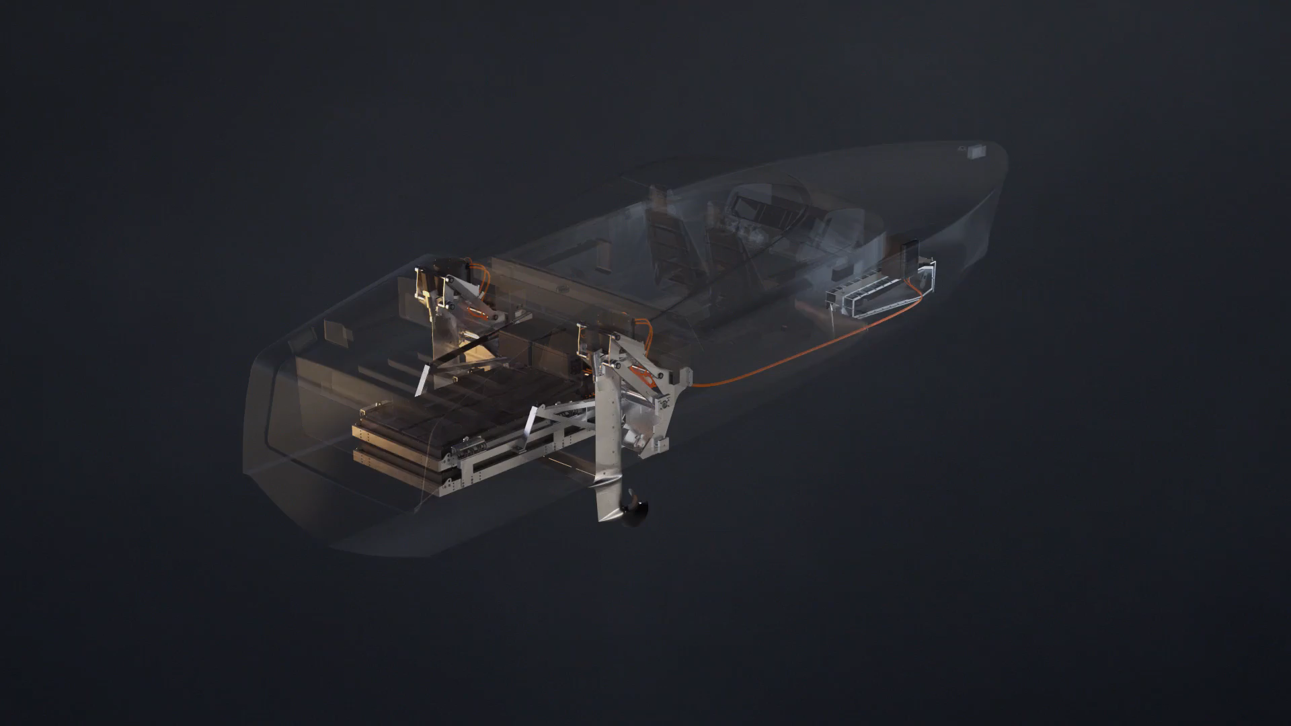
The Project
Dashboard Microservice
Microservice
Retraction Stern PCB

